Slide 1

DEPARTMENT OF ELECTRONICS AND COMMUNICATION ENGINEERING
SCHOOL OF ELECTRICAL & COMMUNICATION
10214EC501
COMMUNITY SERVICE PROJECT
SUMMER SEMESTER(2023-2024)
REVIEW - II
“SENSOR FOR MONITORING SOIL MOISTURE”
SUPERVISED BY
DR.JOSEPHINE PON GLORIA J
ASSISTANT PROFESSOR
PRESENTED BY
1. J.MANINDRA (VTU19769) (21UEEC0109)
2. N.JAI PRAKASH (VTU20914) (21UEEA0200)
3. J.ESWARA VENKATA SAI (VTU20999) (21UEEC0112)

Slide 2
Agenda
ABSTRACT
INTRODUCTION
OBJECTIVES
INTRODUCTION ABOUT VILLAGE
LITERATURE SURVEY
ACTIVITY LOG
SURVEY-DETAILS
SURVEY ANALYSIS WITH REPORT
SUGGESTED METHOD
PROTOTYPE/DEVELOPMENT OF NEW SOLUTION
SOCIETY RELEVANT PROBLEM IDENTIFICATION
GEOTAGGED PHOTOS AND DETAIL&VIDEO LINK
AUTHENTICATED SIGNATURES PROOF AND DETAIL
CONCLUSION
REFERENCE

Slide 3
ABSTRACT
Agricultural technology has seen an increasing demand for soil monitoring systems that utilize Machine Learning (ML) and Internet of Things (IoT) to provide accurate data extraction and analysis. Soil moisture is a critical parameter in agriculture, environmental science, and water resource management.
Accurate and timely measurement of soil moisture content is essential for optimizing irrigation, crop yield, and overall land use efficiency. There is a need for providing an in-depth re view of sensor-based soil moisture monitoring, focusing on various sensor types, working principles, applications, advantages, and challenges associated with this technology.
Each type is explored in detail, explaining its mechanisms for measuring soil moisture and the advantages and limitations of their use. The selection of most suitable sensor type based on specific applications and environmental conditions are analyzed and are explained clearly to the farmers about its usage.
The farmers can get a clear idea about the usage of sensors for soil monitoring and can get all the information about the soil moisture content in their mobile phone. This will help them to analyze and do the appropriate plantation according to the moisture content and will lead to high yield.

Slide 4
INTRODUCTION
SOIL MOISTURE CONTENT:
In agriculture, soil moisture content plays a pivotal role in determining the success of crop cultivation. The amount of water present in the soil directly impacts plant growth and overall crop yield. Farmers and agronomists closely monitor soil moisture levels to ensure that they provide the right amount of irrigation to their crops. An optimal soil moisture content ensures that plants receive adequate water for their growth and development. However, both excessive moisture and drought conditions can have detrimental effects on crops.
SOIL TYPES:
Soil is a natural resource that can be categorized into different soil types, each with distinct characteristics that provide growing benefits and limitations. Identifying the type of soil you require for a project is paramount to support the healthy growth of plant life. Soil can be categorized into sand, clay, silt, peat, chalk and loam types of soil
CLAY SOIL:
Clay Soil is a heavy soil type that benefits from high nutrients. Clay soils remain wet and cold in winter and dry out in summer.

Slide 5
SANDY SOIL:
Sandy Soil is light, warm, dry and tends to be acidic and low in nutrients. Sandy soils are often known as light soils due to their high proportion of sand and little clay. These soils have quick water drainage and are easy to work with. They are quicker to warm up in spring than clay soils but tend to dry out in summer
LOAM SOIL:
Loam soil is a mixture of sand, silt and clay that are combined to avoid the negative effects of each type. These soils are fertile, easy to work with and provide good drainage. Depending on their predominant composition they can be either sandy or clay loam.
SILT SOIL:
Silt Soil is a light and moisture retentive soil type with a high fertility rating. As silt soils compromise of medium sized particles they are well drained and hold moisture well. As the particles are fine, they can be easily compacted and are prone to washing away with rain. By adding organic matter, the silt particles can be bound into more stable clumps.

Slide 6
OBJECTIVES
AIM OF THE PROJECT:
The aim of this project is to create a new way to measure how wet the soil is from a distance. We create awareness on special material that can absorb certain kinds of waves that are used for this purpose very well. This project will help farmers to detect the soil moisture.
SCOPE OF THE PROJECT:
The scope of this project is broad and has the potential to create lasting positive effects by addressing real-world challenges related to soil moisture monitoring.
This is quite promising and can have a significant impact in various domains. The datas can also be linked with IoT module to give notifications and warnings to the farmers about soil temperature and to predict the future water level in the soil.
Modern technologies like WiFi, Bluetooth, and AI are used by IoT networks. Because of its streamlined hardware, which includes inexpensive microcontrollers, low-cost computing units, and wireless sensors, the demand for IoT is increasing every day. Another important consideration is the choice of IoT cloud platform for the system’s development.

Slide 7
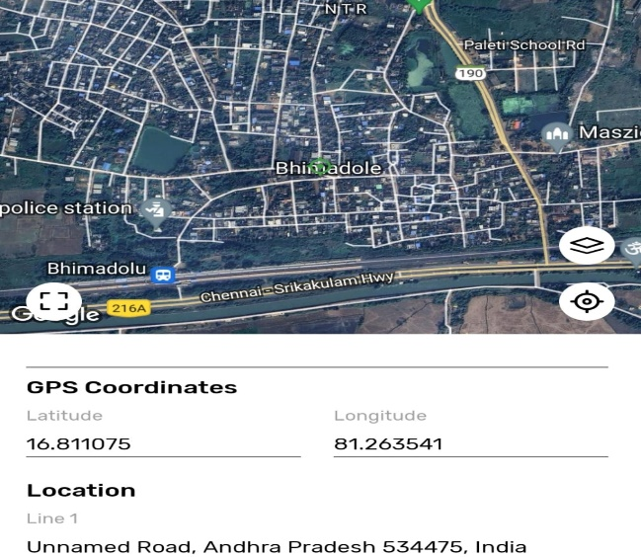
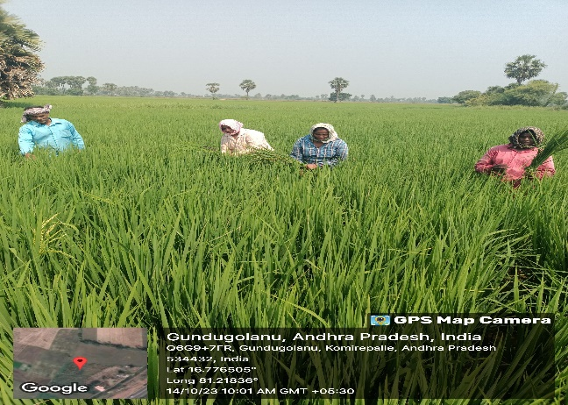
INTRODUCTION ABOUT VILLAGE
Bhimadole is a village located in Eluru District of Andhra Pradesh, India. Which is popularly known as West Godavari.
Our village is a quintessential example of the close relationship between humans and the land. With a rich agricultural heritage that spans generations, farming is not just a way of life here; it's the soul of our community.
The village has a population of about 65,114 people.
The main occupation of the villagers is farming.
These rural communities are often characterized by a strong agrarian economy and are essential for the cultivation of crops and the raising of livestock.
Villagers engage in various agricultural activities, including crop cultivation, animal husbandry, and agro-processing.

Slide 8
LITERATURE SURVEY
Habib et al (2022) stated the use of Wi-Fi and an IoT server, the suggested irrigation system that will be able to monitor the soil’s moisture, temperature, and air temperature as well as relay the information to the user in real-time. Compared to other previously proposed and produced irrigation systems, the IoT-based irrigation system is superior. This is due to the old, expensive, and inefficient way in which autonomous irrigation was previously implemented. As a result, there was a low profit margin and production issues. This study promotes the creation of an automated irrigation system for agricultural monitoring through IoT connection.
The implementation model has the potential to be more efficient, accurate, and responsive in a relatively short amount of time, the authors have been able to confirm thanks to this investigation. The proposed model is superior to existing Internet of Things models because of the benefits it provides over those models. For example, by developing a dashboard based on the HTTP protocol, users will be able to change parameters like moisture and water flow rates through IoT devices and turn on and off water pumps. In the future, it may be possible to integrate sensor grids to determine critical factors like pH, CEC, SAR, organic soil components, and other characteristics. The paper is created using an algorithm to support the title and a critical analysis of recent literature.

Slide 9
Sharma et al (2021) stated precision agriculture utilizes advanced technology to assist farmers in obtaining optimal results with minimal input. This technology includes smart sensors, actuators, satellite imagery, robotics, and drones equipped with Internet of Things (IoT) capabilities. By collect- ing real-time data, these tools enable farmers to make informed decisions without the need for human intervention. Artificial intelligence (AI) plays a vital role in precision agriculture, helping to automate intelligent behavior and benefitting numerous aspects of daily life. In recent research, authors have explored the applications of machine learning (ML) in precision agriculture. Regression algorithms serve as the foundation for predicting soil characteristics, weather patterns, and crop yields. Deep learning (DL) algorithms such as Convolutional Neural Networks (CNN) and ML classification tech- niques such as Support Vector Machines (SVM), Decision Trees, and Random Forests are utilized to identify plant diseases and weeds.

Slide 10
ACTIVITY LOG
Day/Date1 | Brief Description of the daily activity | Learning Outcome
DAY1 | Survey planning and preparation | Well-structured survey instruments ready for data collection.
DAY2 | Pre-Survey communication | Increased awareness about the upcoming survey and its significance.
DAY3 | Data collection | Gathered valuable insights into the soil moisture knowledge and practices.
DAY4 | Survey with community | Gathered information about soil moisture in our community.
DAY5 | Community Feedback | Enhanced community engagement and inclusion in soil testing.
BATCH NO: 44
DEPARTMENT ELECTRONICS AND COMMUNICATION ENGINEERING
11-10-2023

Slide 11
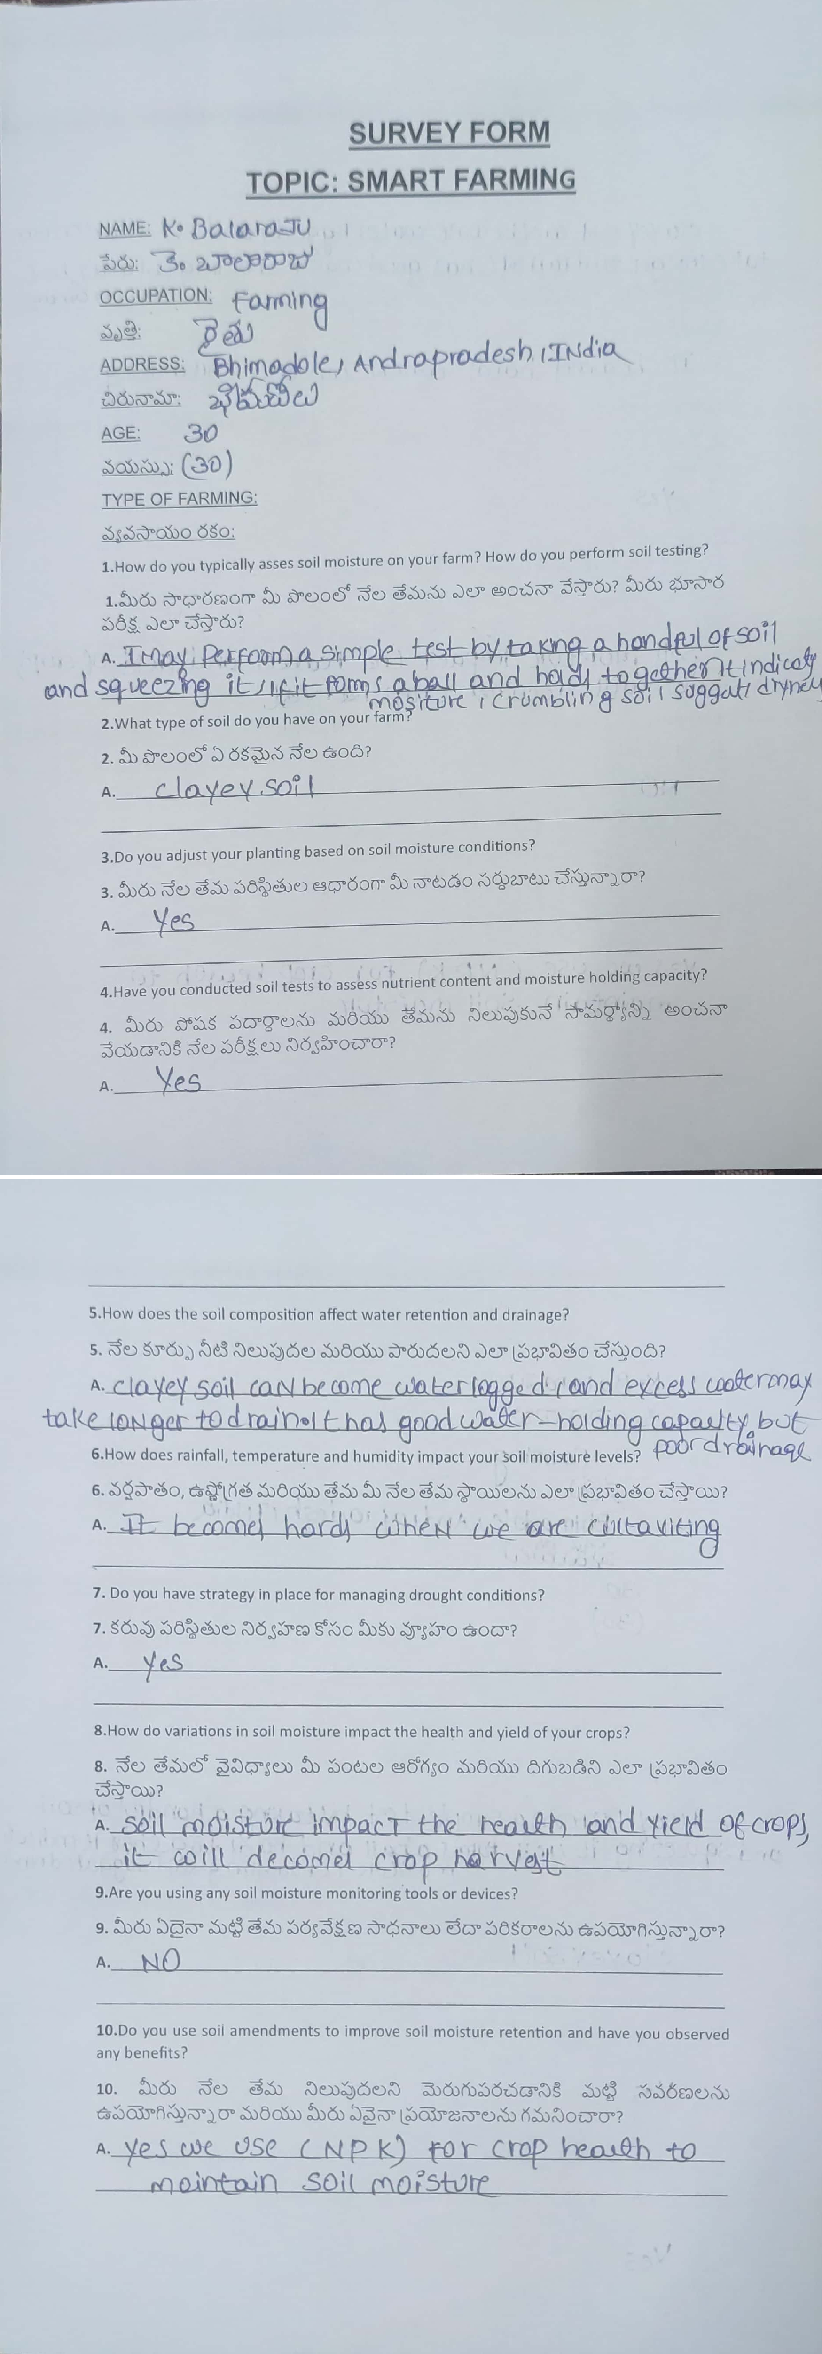
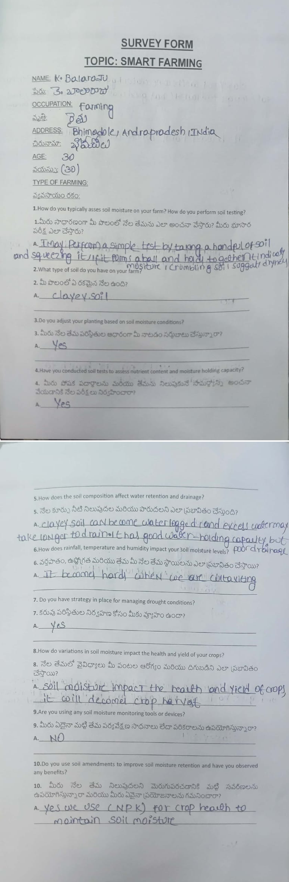
SURVEY-DETAILS
*With Hardcopy Screen Shot
Survey Form Sample 1
Survey Form Sample 2

Slide 12
SURVEY ANALYSIS
Conducted a survey about how to identify the soil moisture content in soil. Mainly conducted a survey in four types of soils like silt, sandy, clay, loam soils. In all these soils observed that clay soil has high moisture content. The survey around 10 farmers about how they check the soil moisture content and what are the tools they are using for testing moisture content.
A survey analysis on agriculture can provide valuable insights into the challenges, opportunities, and trends within this vital sector. The survey delved into various aspects of agriculture, from farming practices to the impact of technology. One notable finding was the growing concern for sustainable farming methods.
Respondents highlighted the need to reduce the environmental footprint of agriculture, emphasizing practices that promote soil health, water conservation, and reduced chemical use.
Sensors will collect the data from the soil and send to the node MCU port. From the node MCU it will send the collected data to the cloud platform. Cloud platform will either store the data or it will send data to the user.The user get the messages to their respective mobile phones. Mobile phones will get the information about the moisture content in the soil. So that the farmers know that which crop is suitable for their soil and also depending upon the climatic changes.

Slide 13
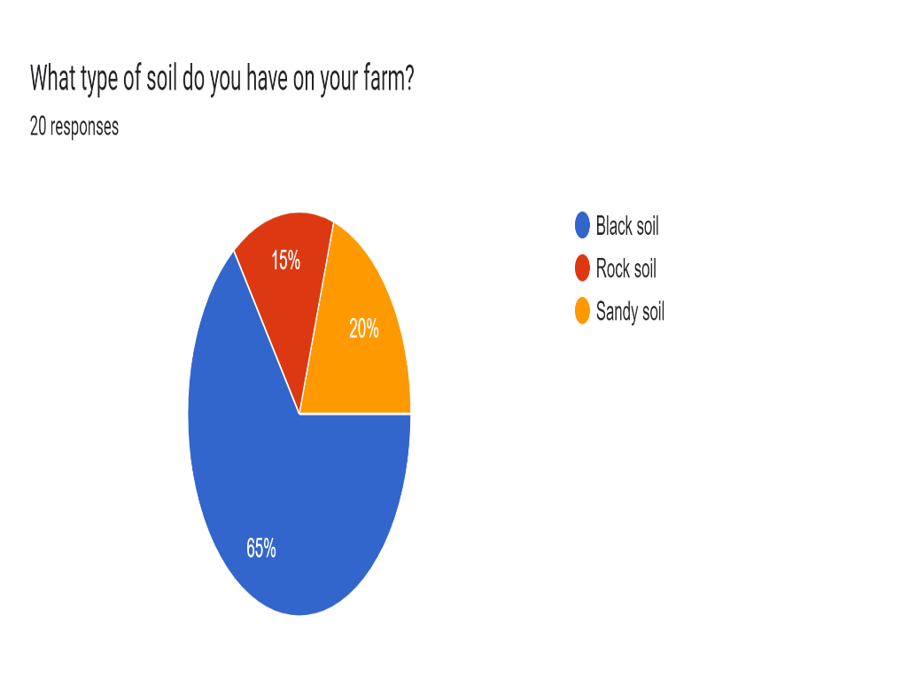
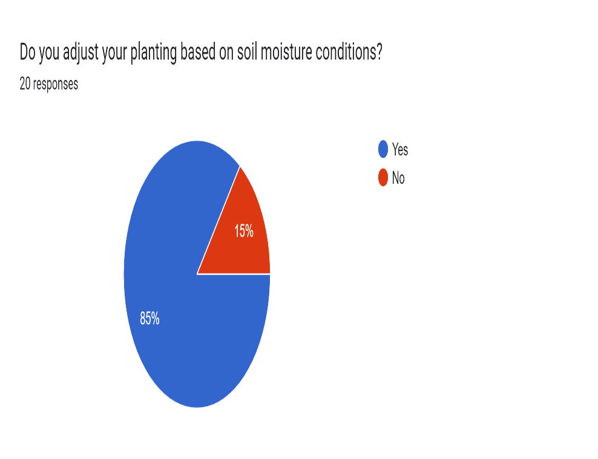
SURVEY ANALYSIS
LINK: https://forms.gle/SB7vWwRVR6LbVXPH7

Slide 14
SUGGESTED METHOD
Precision agriculture aims to optimize crop yield and quality while minimizing waste and reducing the environmental impact of farming practices. Soil monitoring is a critical component of precision agriculture because soil conditions can have a significant impact on crop growth and productivity. An IoT-based soil monitoring system can provide farmers with real-time data on soil moisture levels, temperature, and nutrient content, allowing them to make informed decisions about when and how much to irrigate, fertilize, and manage their crops. This can help farmers optimize resource usage, reduce water waste, and increase crop yields and quality. By monitoring soil conditions continuously, farmers can also detect changes in soil quality and address issues before they negatively impact crop growth. This can help reduce crop losses and increase the sustainability of farming practices.

Slide 15
PROTOTYPE/DEVELOPMENT OF NEW SOLUTION
The “Sensor For Monitoring Soil Moisture” is a transformative project aimed to empowering farmers of Bhimadole Village.
The core of the device is a probe that is inserted into the soil. This probe contains sensors that measure the electrical properties of the soil to determine its moisture content.
The sensor is connected to a data logger, which records and stores moisture readings over time. It can be a standalone device or connected to a central data management system.
Some advanced sensors have communication capabilities (e.g., Wi-Fi, LoRa, or cellular) to transmit data to a central database or user interface for real-time monitoring.
The sensor may be powered by batteries, solar panels, or other energy sources depending on the application.
BATCH NO:44 DEPARTMENT ELECTRONICS AND COMMUNICATION ENGINEERING

Slide 16
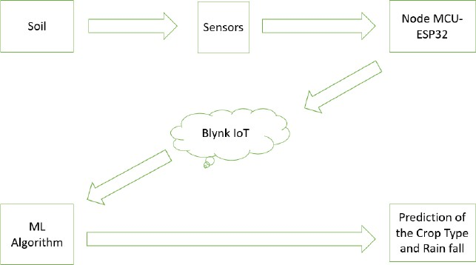
BLOCK DIAGRAM OF SUGGESTION SYSTEM

Slide 17
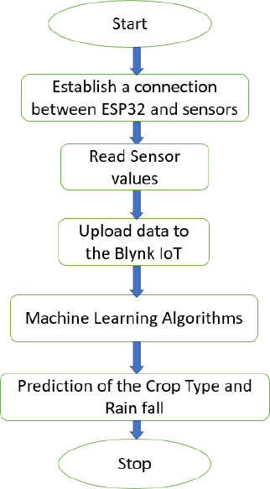
FLOW CHART

Slide 18
SOCIETY RELEVANT PROBLEM IDENTIFICATION
While soil moisture sensors can greatly benefit farmers, there may be disparities in access, particularly in economically disadvantaged areas. Ensuring that these sensors are affordable and accessible to a wide range of farmers is a challenge.
Soil moisture sensors typically require a power source. In regions with unreliable or no access to electricity, finding sustainable and low-energy solutions for these sensors is a challenge.
Soil moisture data, like other agricultural data, can be sensitive. Ensuring that the data collected by these sensors is secure and respecting the privacy of farmers is a critical concern.
Farmers need to understand how to use these sensors effectively. Providing education and training on how to interpret and act on soil moisture data is crucial for their successful implementation.
BATCH NO:44 DEPARTMENT ELECTRONICS AND COMMUNICATION ENGINEERING

Slide 19
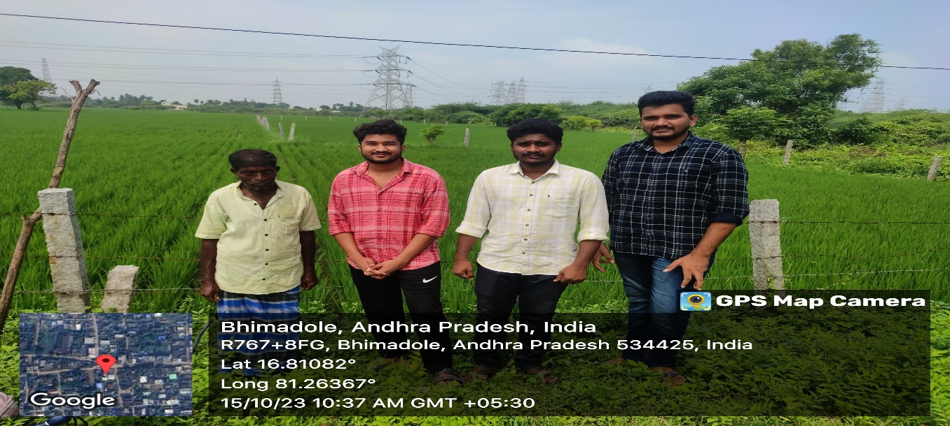
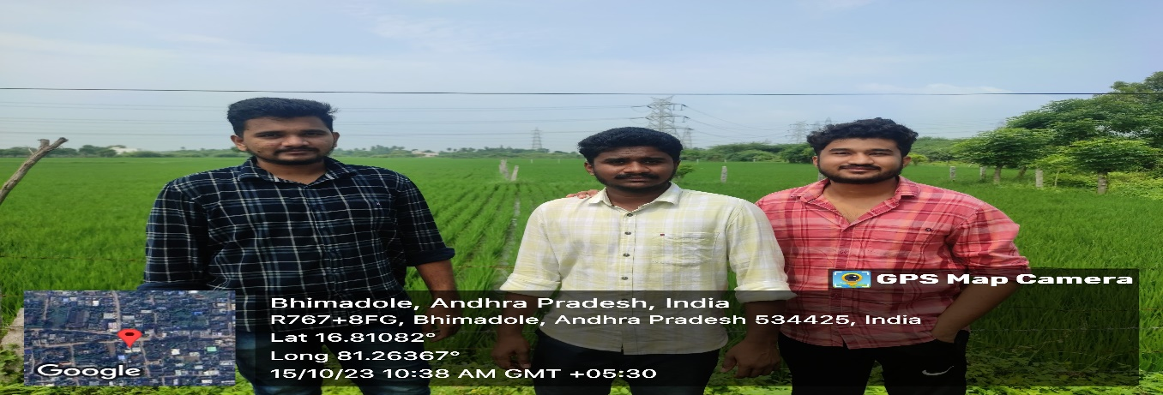
GEO TAGGED PHOTOS ,VIDEO LINK
VIDEO LINK : https://screenpal.com/watch/c0XjiOVGX3r
BATCH NO:44 DEPARTMENT ELECTRONICS AND COMMUNICATION ENGINEERING

Slide 20
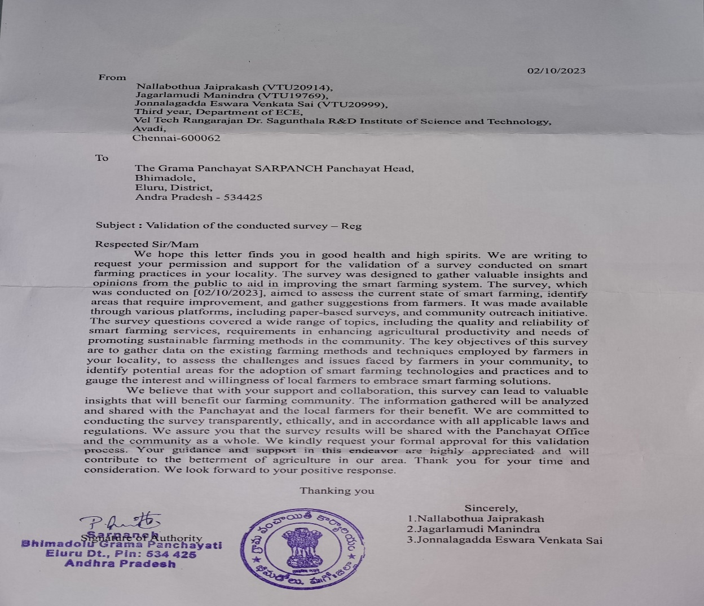
AUTHENTICATED SIGNATURES PROOF AND DETAIL.
BATCH NO:44 DEPARTMENT ELECTRONICS AND COMMUNICATION ENGINEERING

Slide 21
CONCLUSION
This project conveys the usage of new and innovative approach to the farmers on keeping track of soil and environmental conditions in real-time. The system involves monitoring various parameters such as temperature, humidity, moisture content, and pH level, and storing the sensor readings on the Blynk IoT cloud. Users can conveniently access the data using the Blynk IoT An- droid application. Data analysis is performed using a hybrid algorithm that employs machine learning techniques. By gathering information on the aforementioned parameters, the proposed model enables farmers and agriculturists to make informed decisions regarding crop and rain predictions. Overall, this project presents a valuable contribution to the field of agriculture and environmental monitoring.
Looking ahead to the future, it is anticipated that this soil monitoring system will be ca- pable of monitoring an expanded range of parameters. Moreover, to further augment the system’s capabilities, additional functionalities can be incorporated that furnish users with both visual and auditory notifications, particularly in cases where unfavorable conditions are detected. Such features will provide users with an added layer of protection, enabling them to respond swiftly and effectively to any emerging issues, and ultimately safeguarding their agricultural investments.
BATCH NO:44 DEPARTMENT ELECTRONICS AND COMMUNICATION ENGINEERING

Slide 22
REFERENCES
Habib, S.; Alyahya, S.; Islam, M.; Alnajim, A.M.; Alabdulatif, A.; Alabdulatif, A. Design and Implementation: An IoT-Framework-Based Automated Wastewater Irrigation System. Electronics 2022, 12, 28. https://doi.org/10.3390/electronics12010028.
Contreras-Castillo, J.; Guerrero-Iba˜nez, J.A.; Santana-Mancilla, P.C.; Anido-Rif´on, L. SAgric- IoT: An IoT-Based Platform and Deep Learning for Greenhouse Monitoring. Appl. Sci. 2022, 13, 1961. https://doi.org/10.3390/app13031961 .
Blesslin Sheeba, T.; Anand, L. D. Vijay; Manohar, Gunaselvi; Selvan, Saravana; Wilfred, C. Bazil; Mu. 2022 Machine Learning Algorithm for Soil Analysis and Classification of Micronutrients in IoT-Enabled Automated Farms,accessed (March 04 2022)
Sharma, Abhinav et al. “Machine Learning Applications for Precision Agriculture: A Comprehen- sive Review.” IEEE Access 9 (2021): 4843-4873.

Slide 23
THANK YOU
BATCH NO:44 DEPARTMENT ELECTRONICS AND COMMUNICATION ENGINEERING

